Slide 1
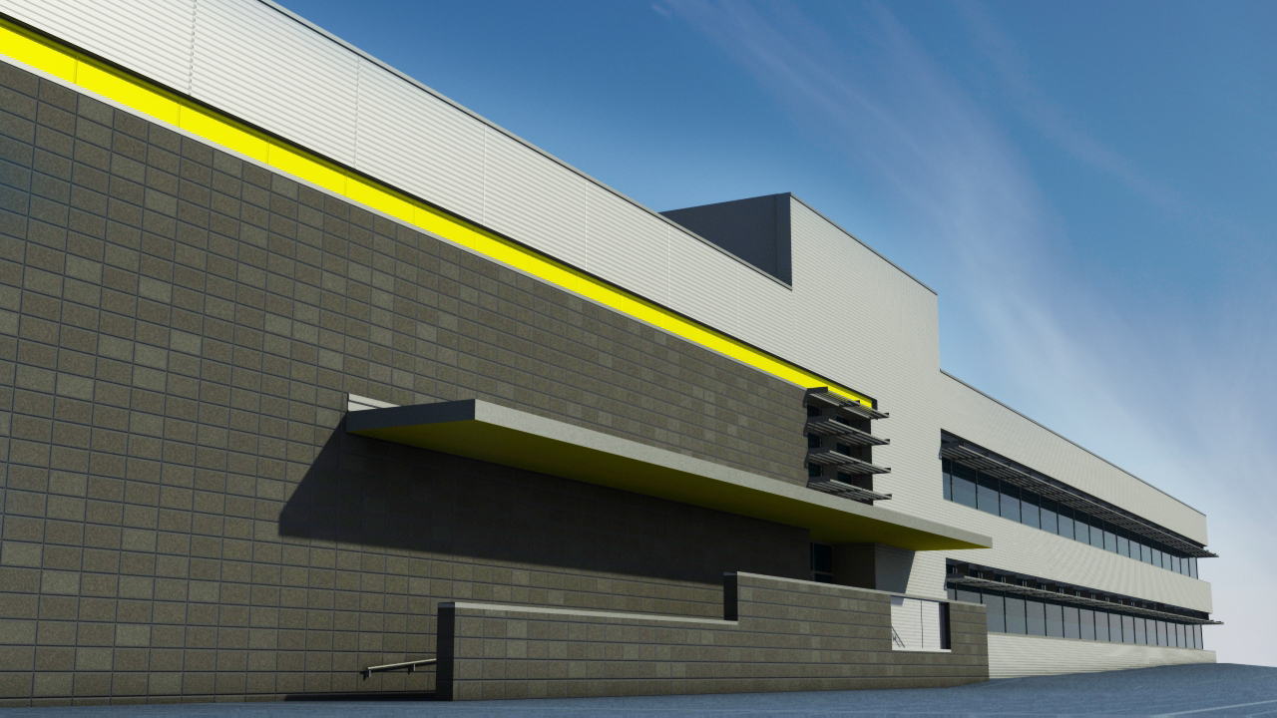
Detroit Integrated Transportation Campus Shane Goodman - Construction Management
AE Senior Thesis 2009

Slide 2
OUTLINE
DITC Overview
Prefab with Precast Brick Panels
Modularization of Interior Walls
Designing the Design Model
Acknowledgments
Questions
Shane Goodman Detroit Integrated Transportation Campus

Slide 3
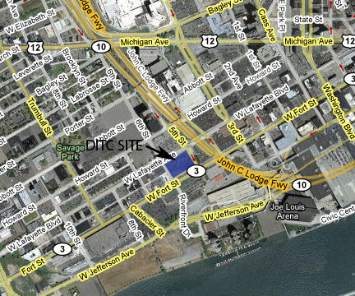
DITC OVERVIEW
Project Delivery Building Information Schedule Cost
Owner State of Michigan
Tenant Michigan DOT & Michigan State Police
Delivery Design-Bid-Build
Architect Barton Malow Design
General Contractor Unknown
Shane Goodman Detroit Integrated Transportation Campus

Slide 4
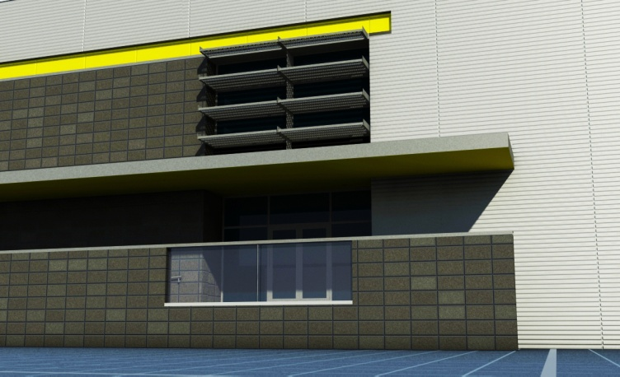
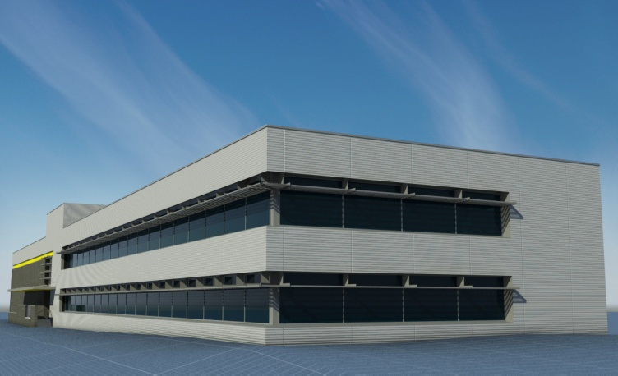
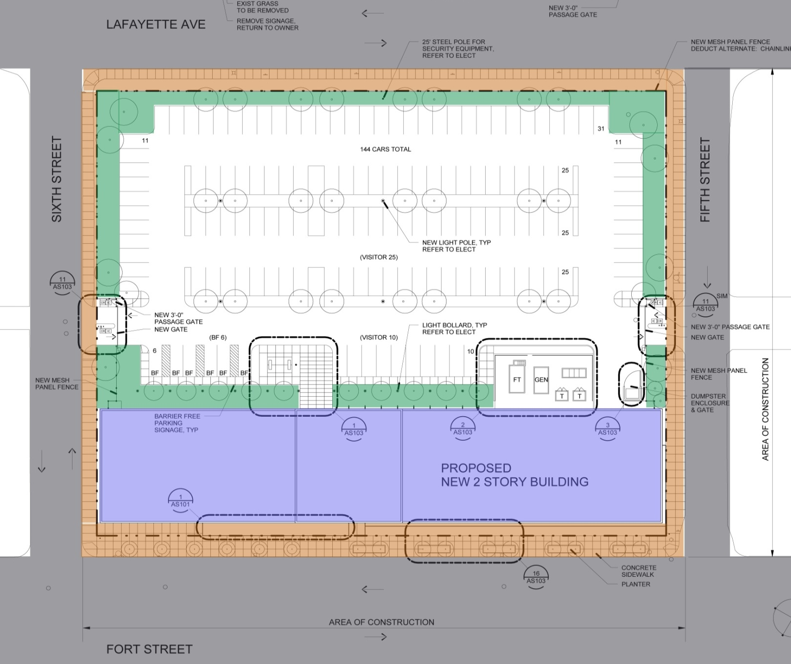
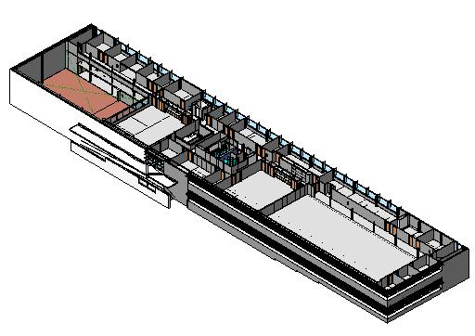
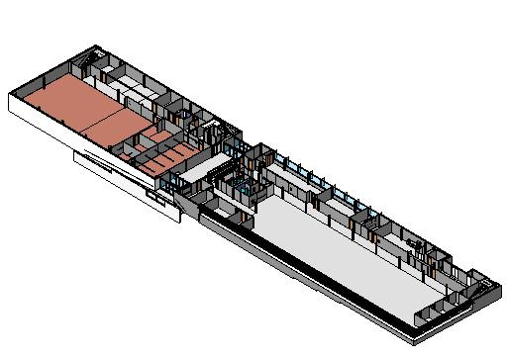
DITC OVERVIEW
Project Delivery Building Information Schedule Cost
Office and 24-hour Operations Center for MDOT and Michigan State Police
2-Story, 45,000 square feet
Metal Panel and Brick with Curtain Wall Windows
Structural Steel: W-Shape and K-Series Roof Joists
First Floor
Second Floor
Shane Goodman Detroit Integrated Transportation Campus

Slide 5
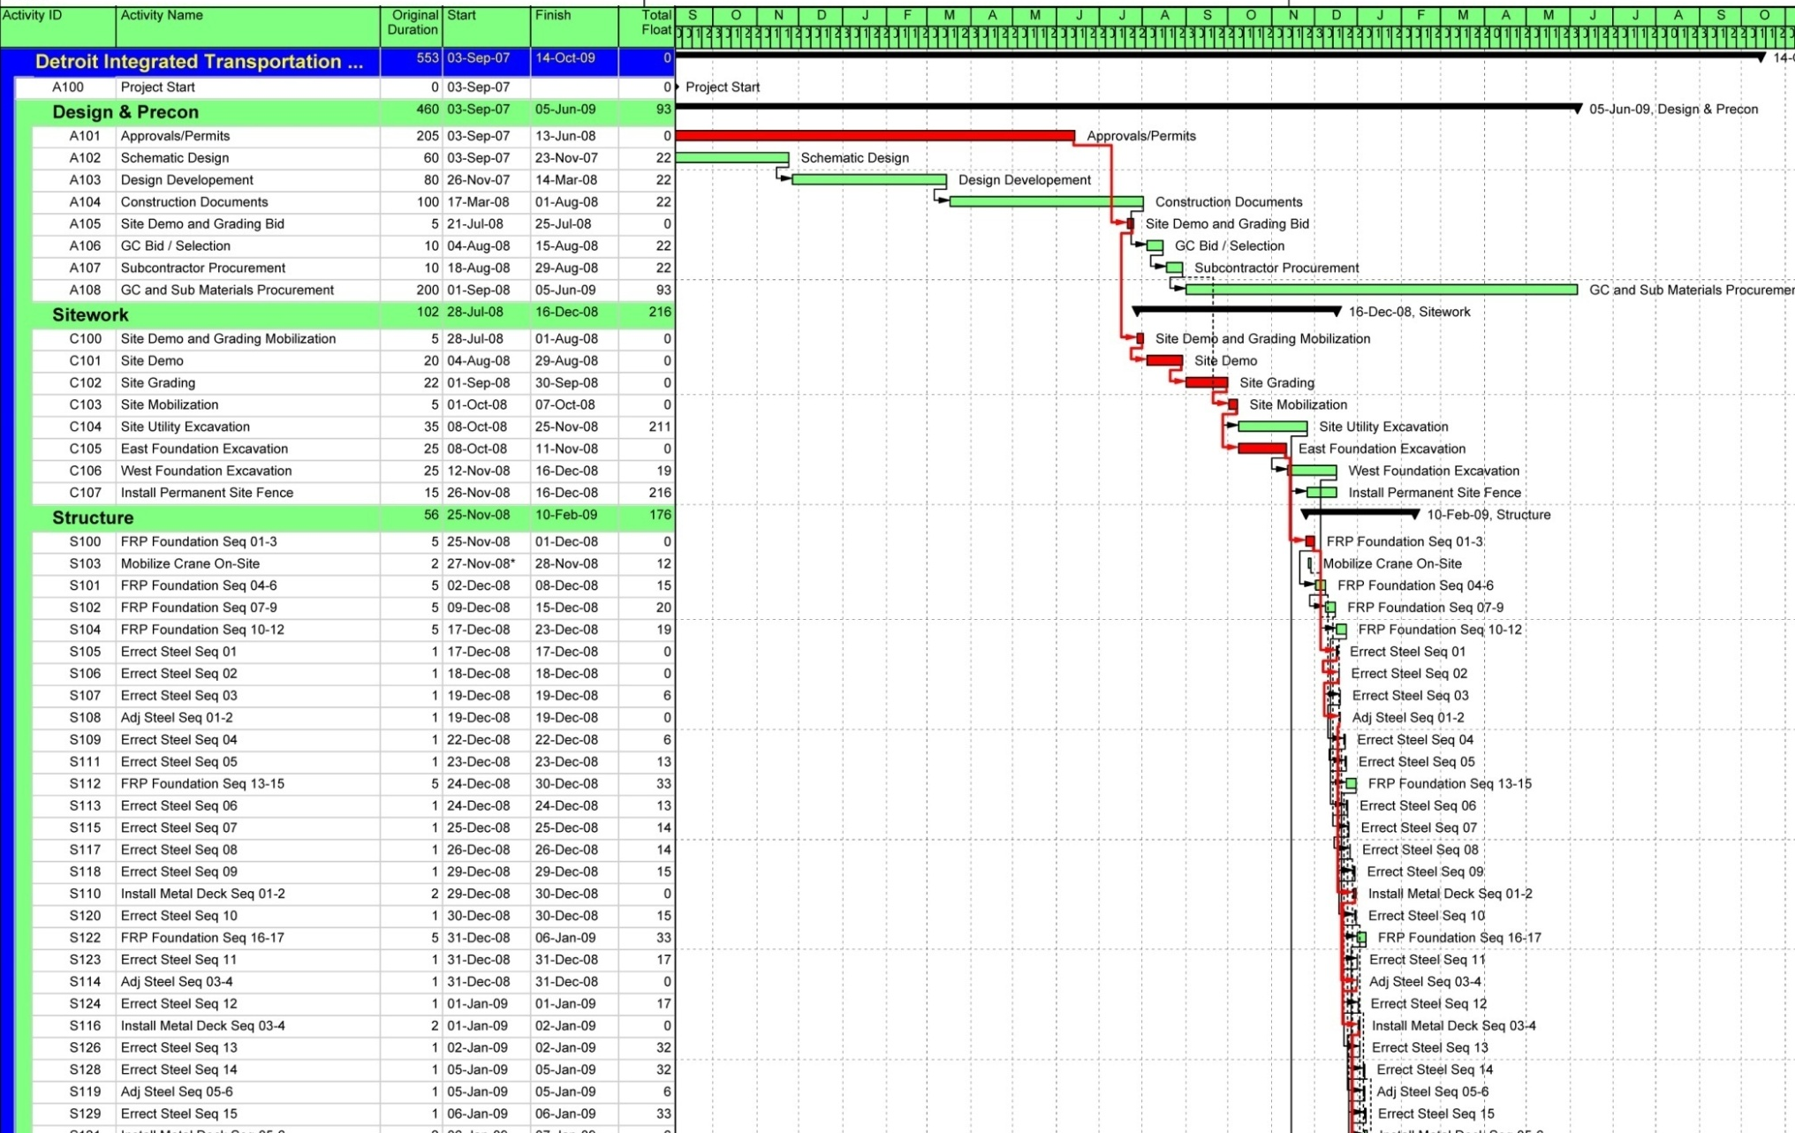
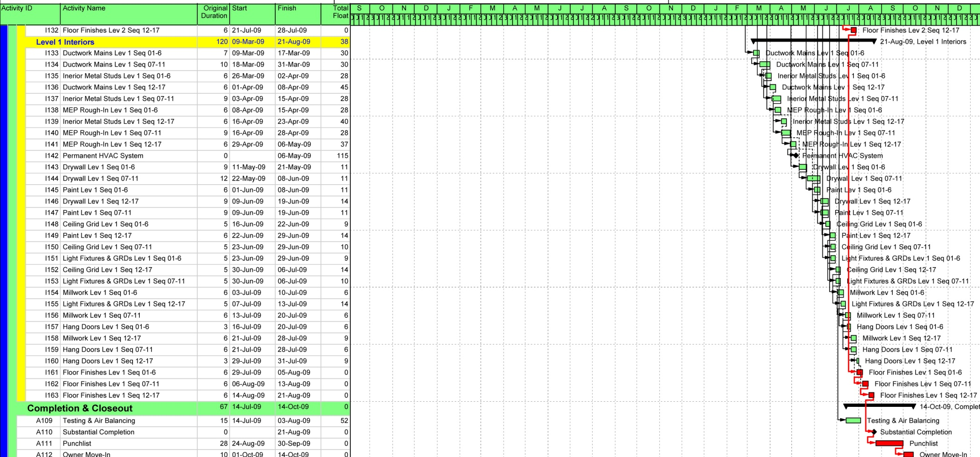
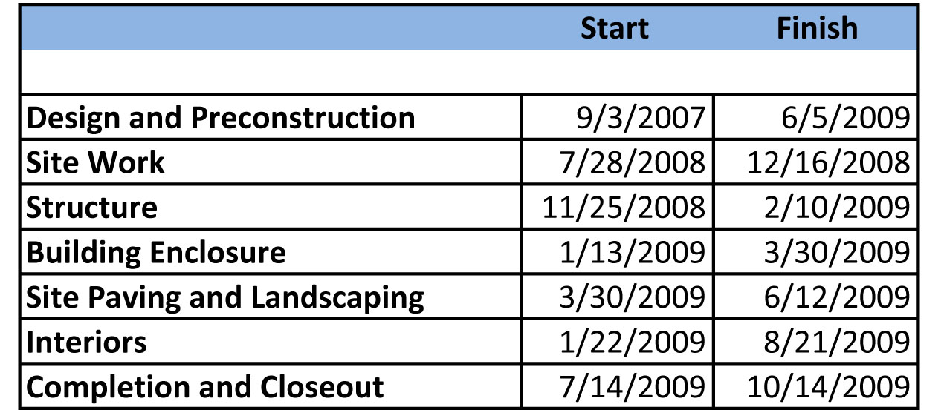
DITC OVERVIEW
Project Delivery Building Information Schedule Cost
100% Construction Documents completed – June, 2008
Construction originally supposed to start – October, 2008
One Year Construction Time Period
Critical Path – Steel, Exterior Framing, Masonry, Drywall, Interior Finishes
Shane Goodman Detroit Integrated Transportation Campus

Slide 6
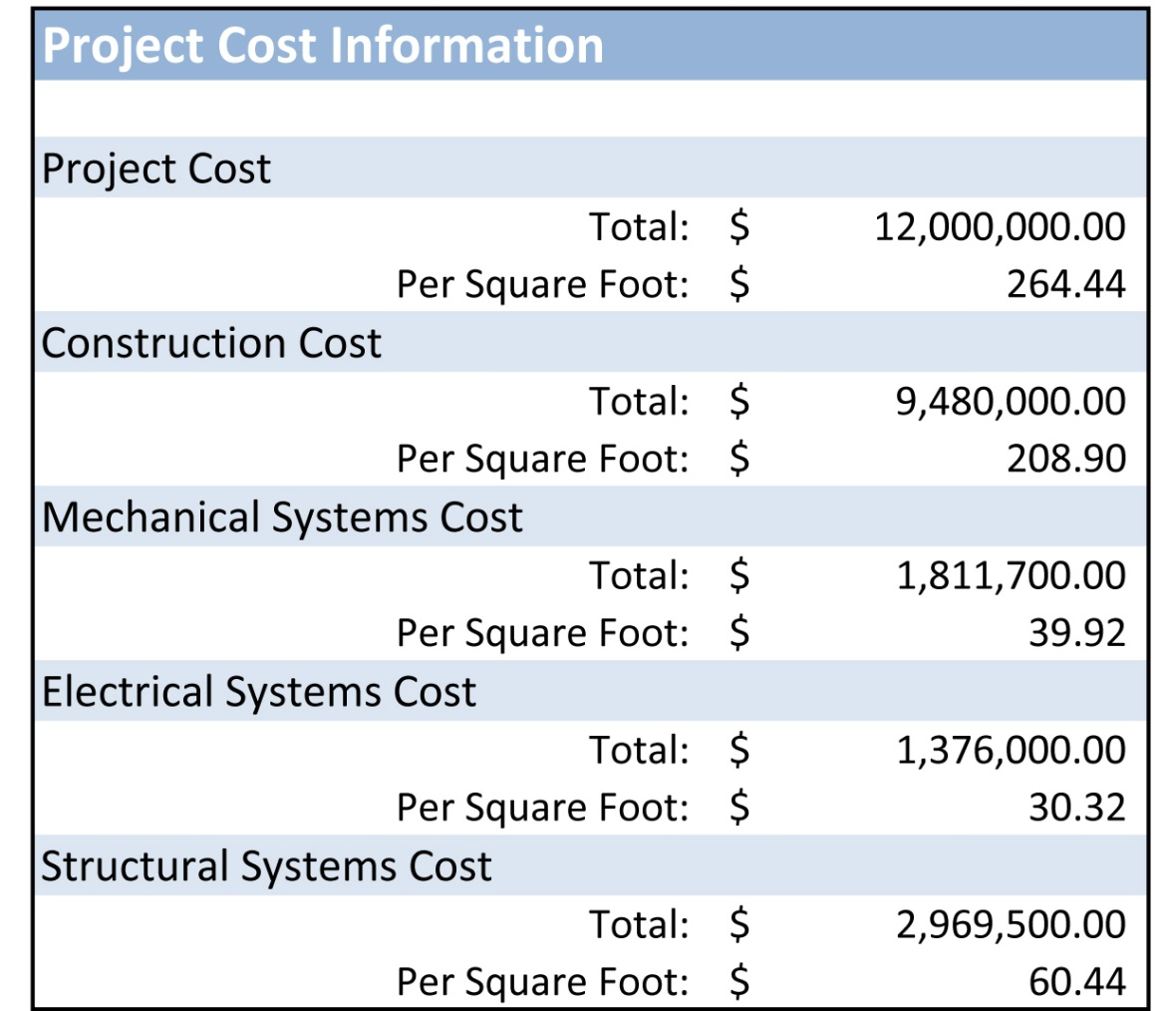
DITC OVERVIEW
Project Delivery Building Information Schedule Cost
Shane Goodman Detroit Integrated Transportation Campus

Slide 7
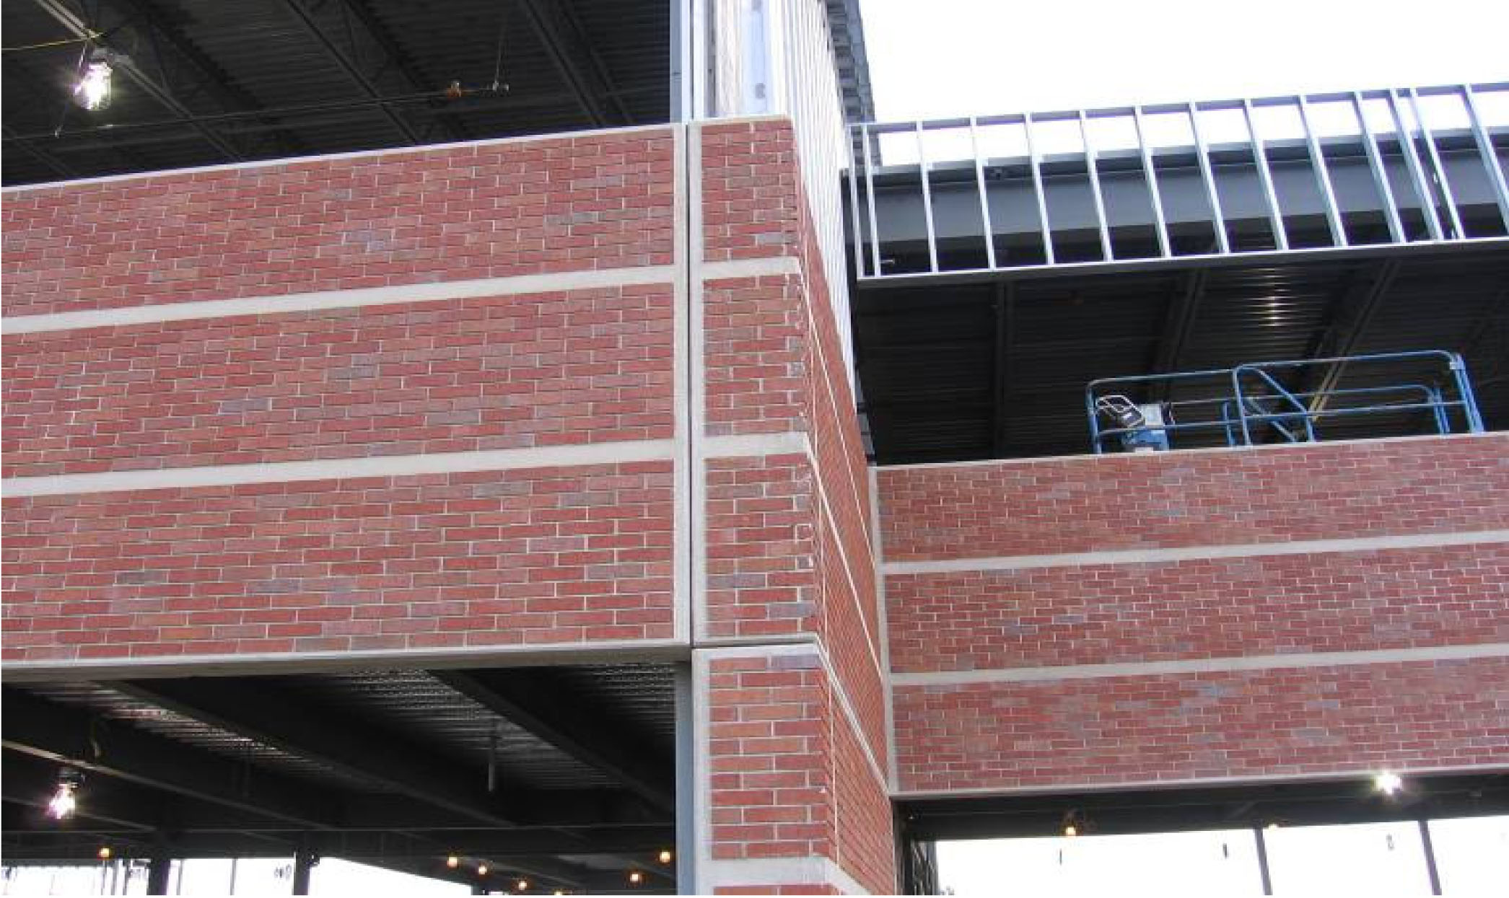
Prefab with Precast Brick Panels
Panel System Structural Schedule Cost Conclusions
Shane Goodman Detroit Integrated Transportation Campus

Slide 8
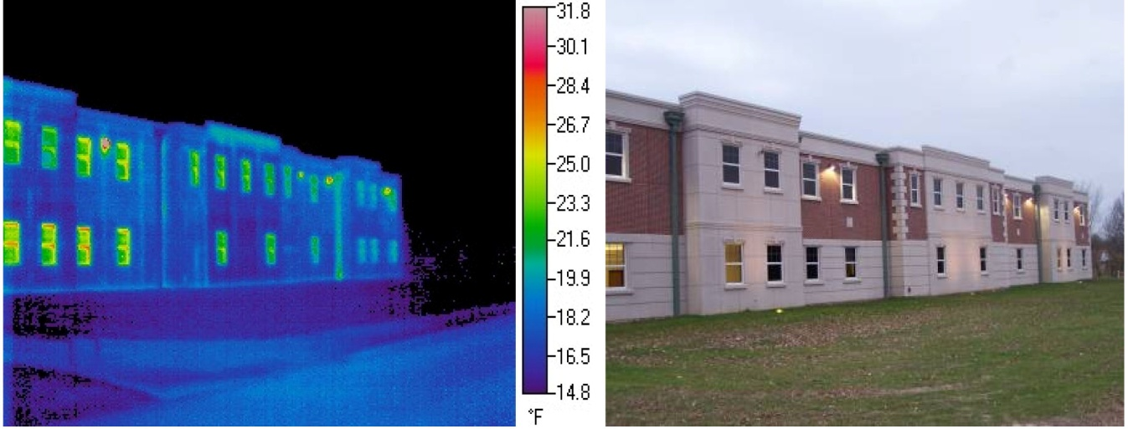
Prefab with Precast Brick Panels
Panel System Structural Schedule Cost Conclusion
Prefabricated: high-speed on-site construction
High R-Value: decrease in heating and cooling loads
3”-2”-5” configuration
Fiber-Composite Connectors: high strength & low conductivity
20’ – 22’ wide x 8’ 6” high (one-third of DITC façade)
Shane Goodman Detroit Integrated Transportation Campus

Slide 9
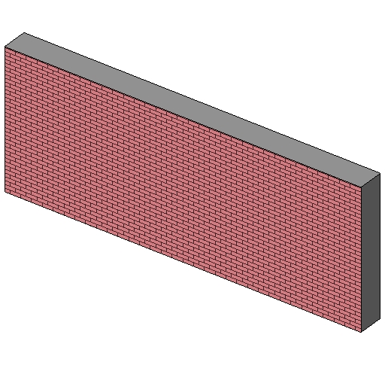
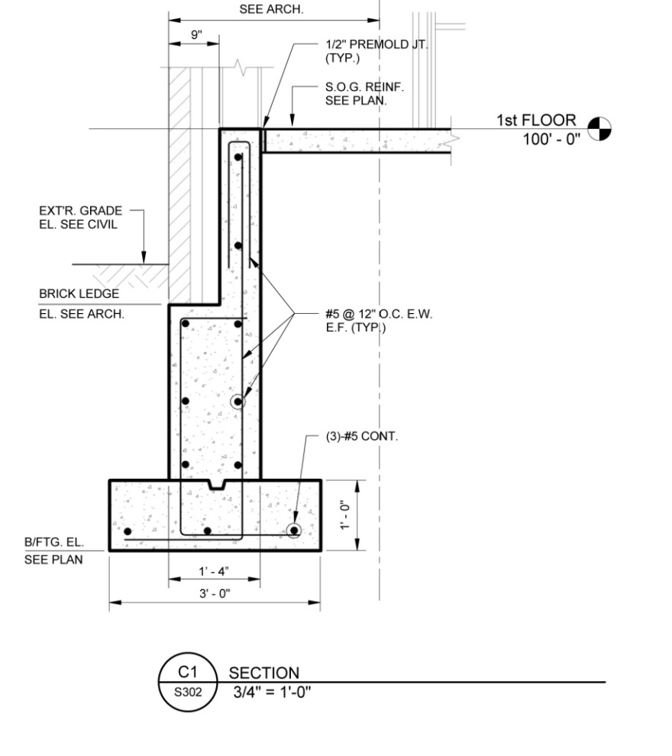
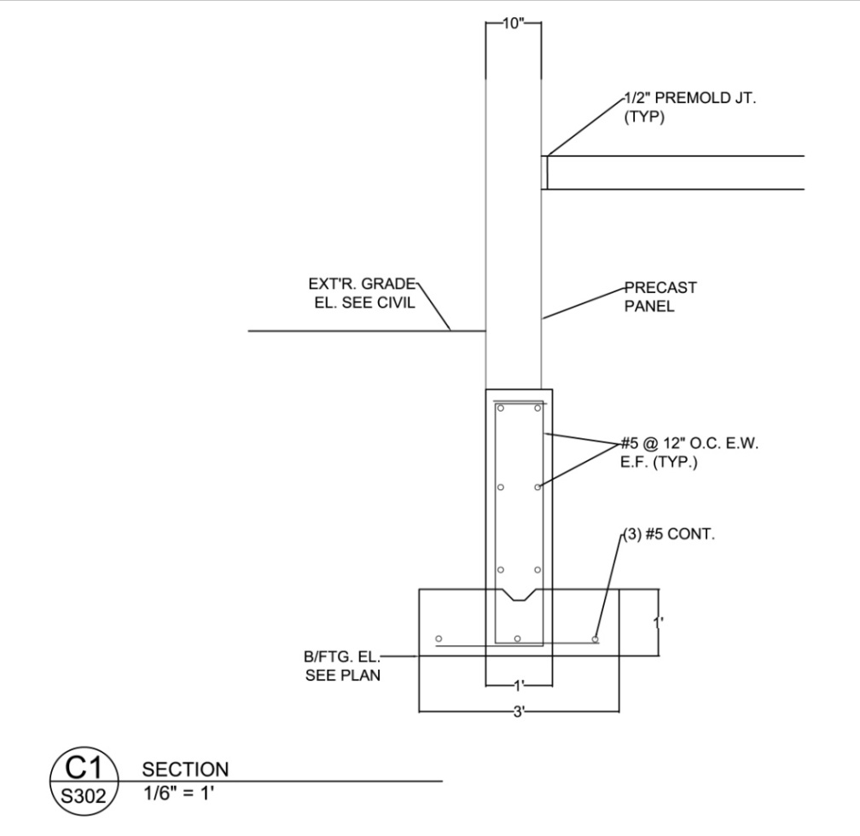
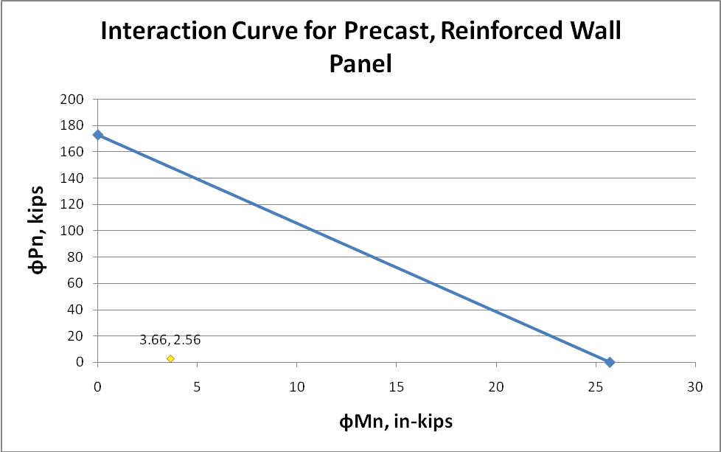
Prefab with Precast Brick Panels
Panel System Structural Schedule Cost Conclusion
Wind: 90 mph, 1.15 Importance Factor, Exposure Category B
Interior Zone: 16 PSF
Exterior Zone: 18 PSF
Bearing: 1.71 kips from above panels, 2.56 kips reaction at base
Vertical Direction (Flexure and Compression)
Mu = .305 foot-kips ≤ ФMn = 2.14 foot-kips
Pu = 2.56 kips ≤ ФPn = 173 kips
Horizontal Direction (Flexure)
Mu = 1.05 foot-kips ≤ ФMn = 2.14 foot-kips
8.5’
Footing Design
Vu = .853 kips ≤ 1/2ФVc = 5.92 kips
Qu = 853 psf ≤ 1500 psf (IBC Allowable bearing capacity of clays)
22’
Shane Goodman Detroit Integrated Transportation Campus

Slide 10
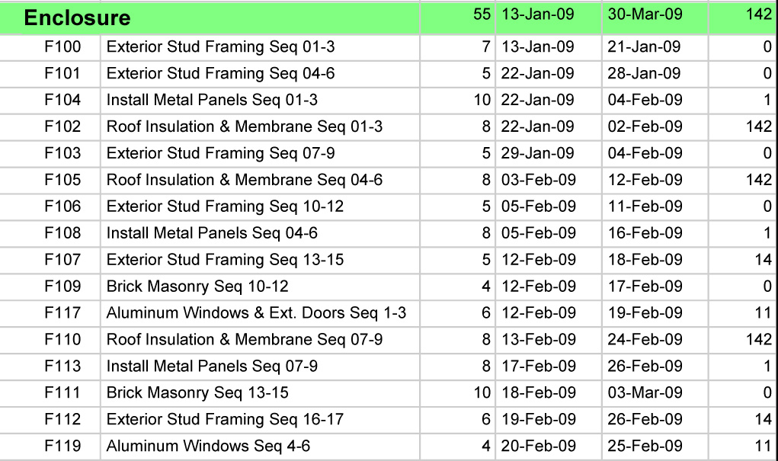
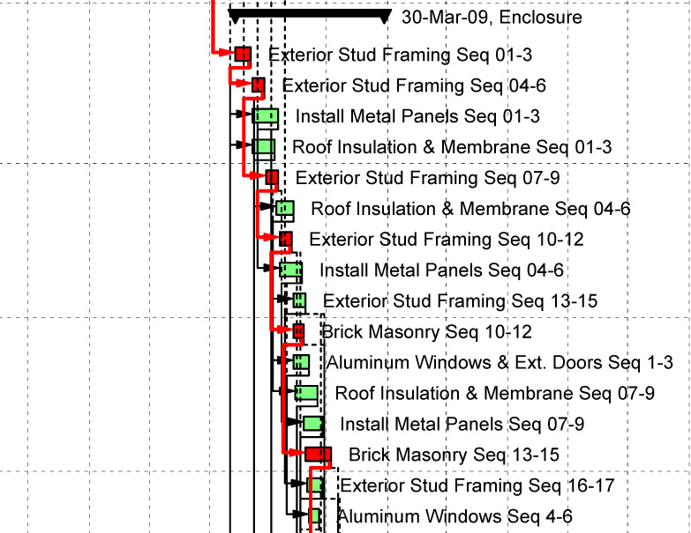
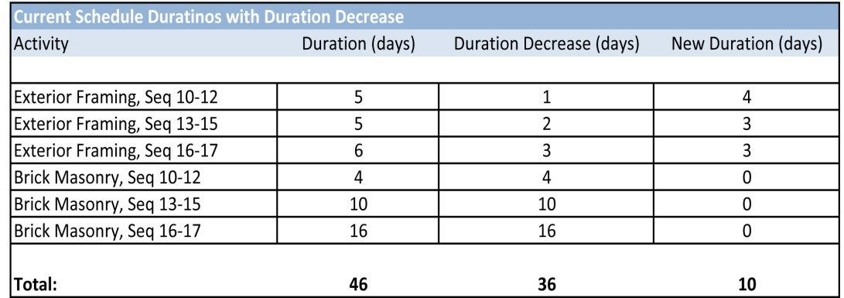
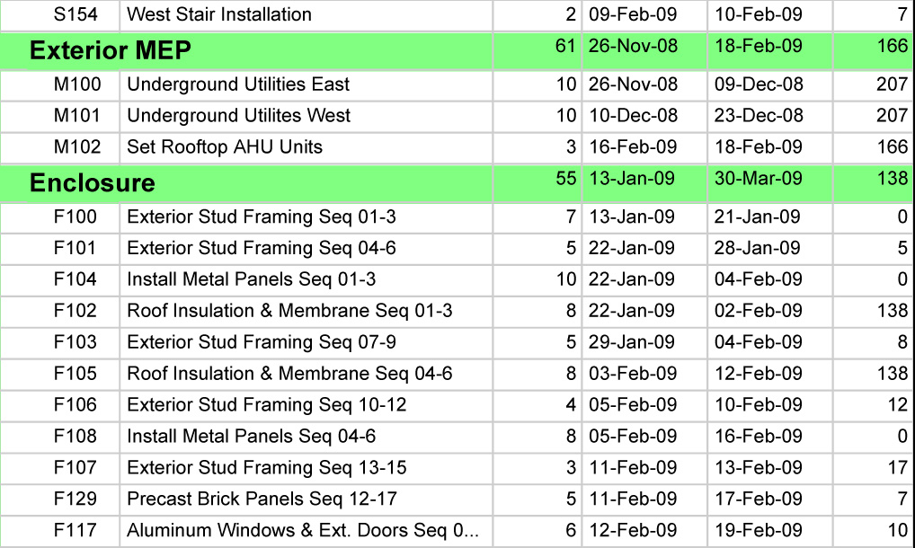
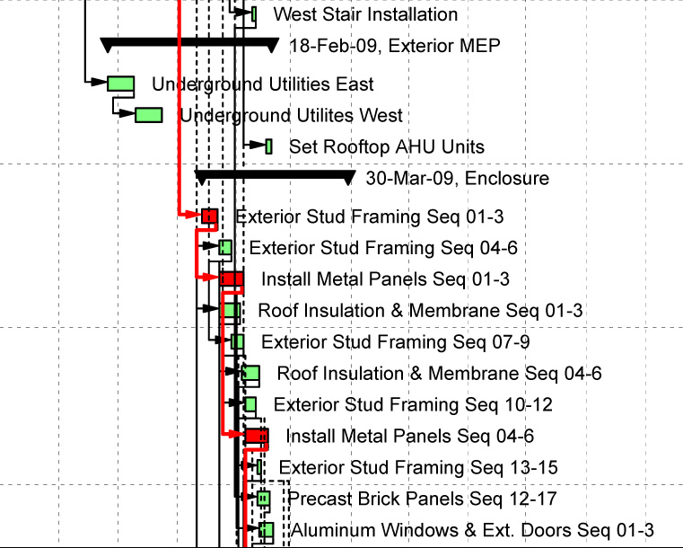
Precast Panel Schedule Original DITC Schedule
Prefab with Precast Brick Panels
Panel System Structural Schedule Cost Conclusion
Construction Schedule only decreased by 3 days
General Conditions savings at $ 633 per day = $ 1,900
Increases Schedule Reliability
Drafting and Engineering: 4 weeks
Fabrication: 4 weeks
Erection: 1 week
Clean-up and Detailing: 1 week
31 days of duration saved
Precast was added, Brick was taken off, Exterior Framing durations changed
Double construction speed of Metal Panels:
Construction Schedule can decrease by 22 days
Shane Goodman Detroit Integrated Transportation Campus

Slide 11
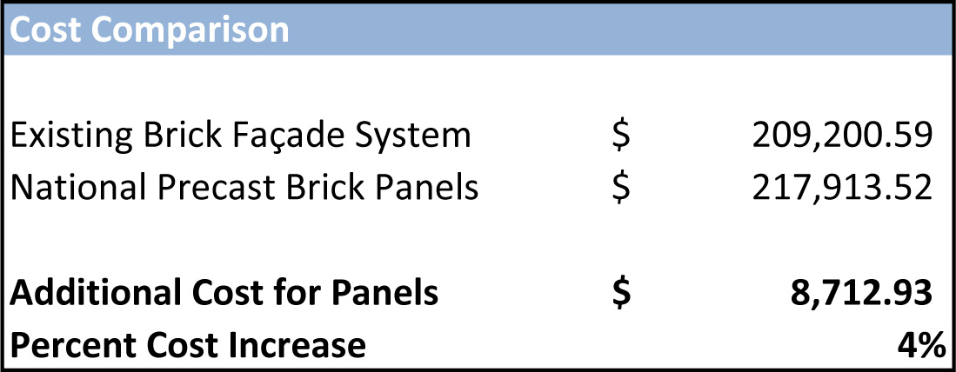
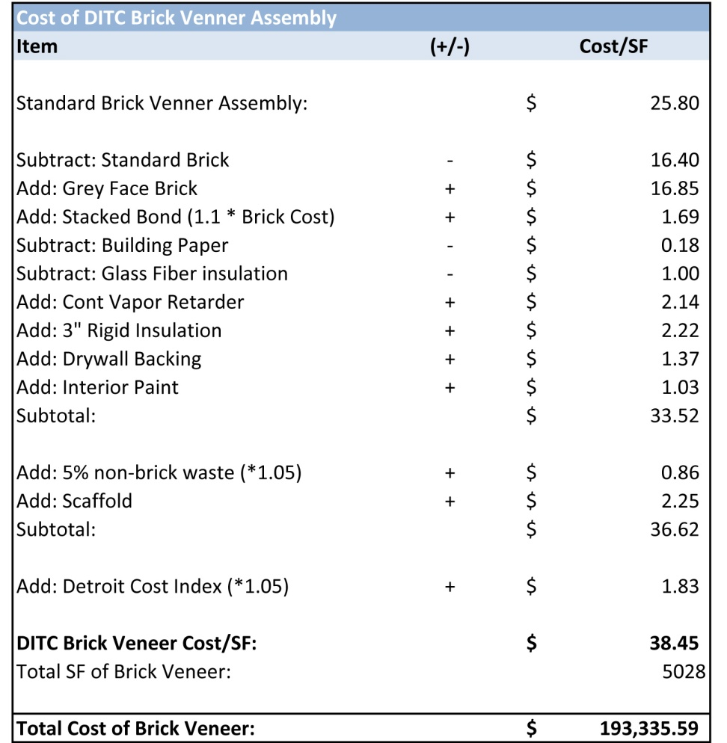
Prefab with Precast Brick Panels
Panel System Structural Schedule Cost Conclusion
National Precast Estimate: $ 215,850 or $ 42.93 / SF
Payback Period
$ 453 annual savings in heating and cooling costs
$ 8,712 / $ 453 per year =
Payback Period of 19 years
Shane Goodman Detroit Integrated Transportation Campus

Slide 12
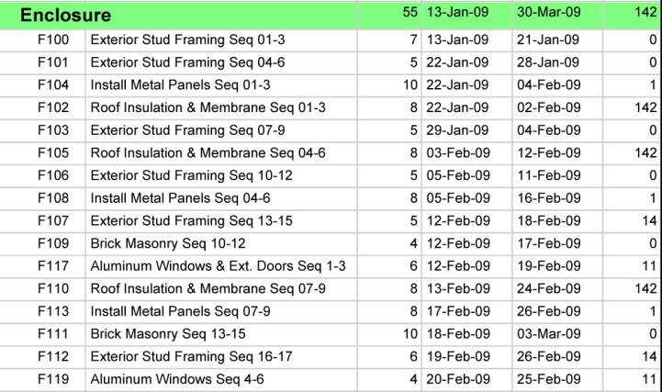
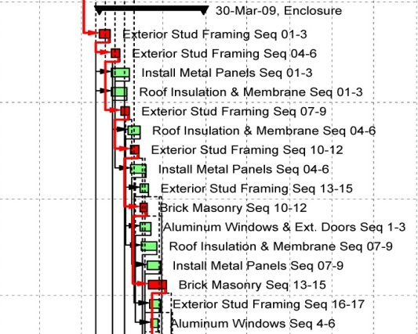
Lesson Learned
Consider activities other than critical path activities when looking to accelerate
Hypothetically test acceleration scenarios on CPM schedule to evaluate
Prefab with Precast Brick Panels
Panel System Structural Schedule Cost Conclusion
31 days of duration saved with 3 days of Construction Schedule saved
More reliance in schedule, with opportunity to accelerate metal panels
Increase of $8,712 in total cost (4% increase)
Payback period of 19 years with heating and cooling load savings
Shane Goodman Detroit Integrated Transportation Campus

Slide 13
Modularization of Interior Walls
IrisWall System Schedule Cost Conclusion
Shane Goodman Detroit Integrated Transportation Campus

Slide 14
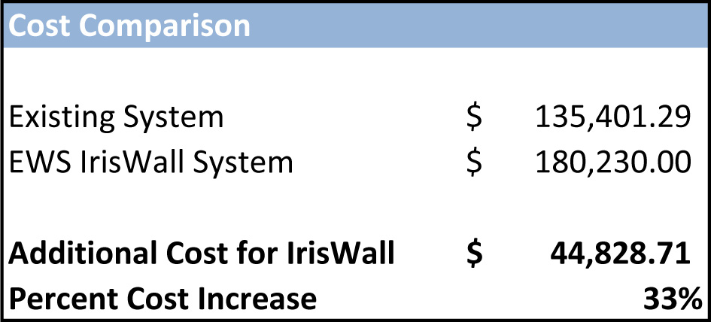
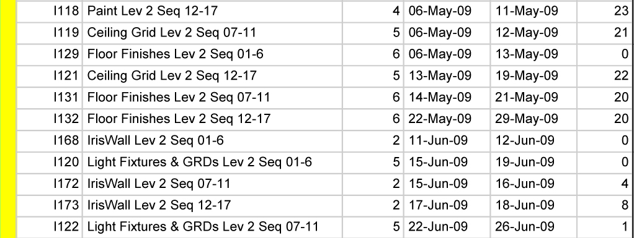
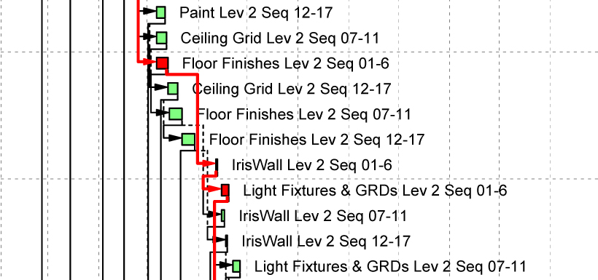
Modularization of Interior Walls
IrisWall System Schedule Cost Conclusion
Total Duration Saved = 44 days
IrisWall
Located near Cleveland, Ohio
Prefabricated using Recyclable materials, Water-based finishes
IrisWall substituted for drywall in areas with drop ceiling and not for MEP walls
IrisWall Return on Investment
Tax and Renovation savings
Classified as furniture: 7 year depreciation, compared to 39 years for drywall
Assuming a 10% per year move rate, and 5% inflation rate:
Construction Schedule decreased by 6 days
General Conditions savings at $ 633 per day = $ 3,800
Payback Period for IrisWall on DITC = 60 months
Shane Goodman Detroit Integrated Transportation Campus

Slide 15
Modularization of Interior Walls
IrisWall System Schedule Cost Conclusion
IrisWall
44 days of duration saved with 6 days of Construction Schedule saved
More float in schedule, less opportunity for delays
Increase of $44,800 in total cost (33% increase), but more flexible design
Payback period of 60 months due to renovation and tax savings
Shane Goodman Detroit Integrated Transportation Campus

Slide 16
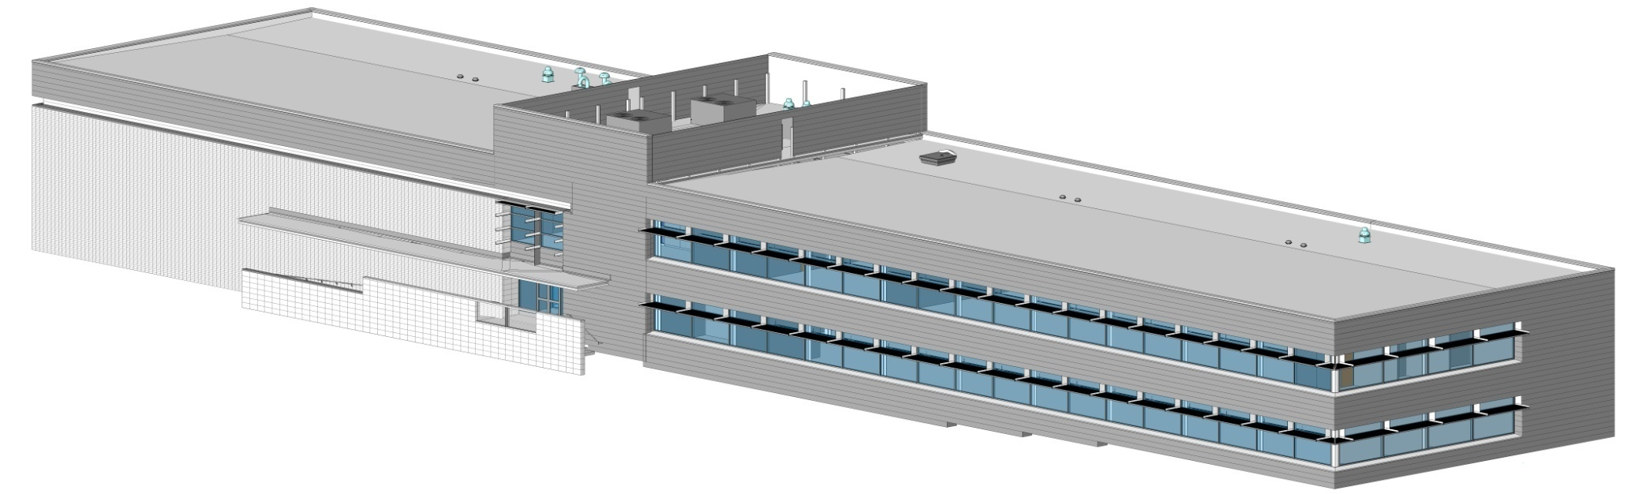
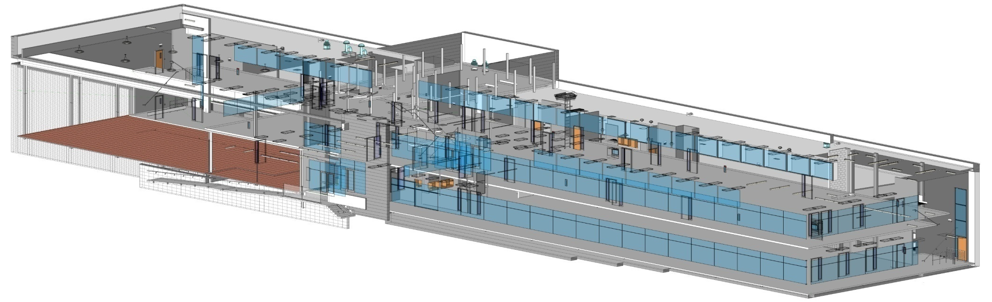
Designing the Design Model
Introduction Process Mapping MPR Conclusion
Shane Goodman Detroit Integrated Transportation Campus

Slide 17
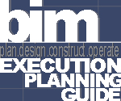
BIM Execution Planning Guide
Help early project participants reach decisions on and plan for BIM Implementation
Process Mapping to establish a workflow for specific BIM uses
Research Goals
Create process maps for developing a 4D model
Develop a tool for defining the progression of a model throughout a project lifecycle
Apply process mapping and model progression tool to the DITC
Designing the Design Model
Introduction Process Mapping MPR DITC Conclusion
NIST – “Cost Analysis of Inadequate Interoperability in the U.S. Capital Facilities Industry”
Cost of inadequate interoperability among CAD, Engineering and Software Systems
$ 15.8 billion per year in U.S Capital Facilities Industry
Construction Industry Institute
Shane Goodman Detroit Integrated Transportation Campus

Slide 18
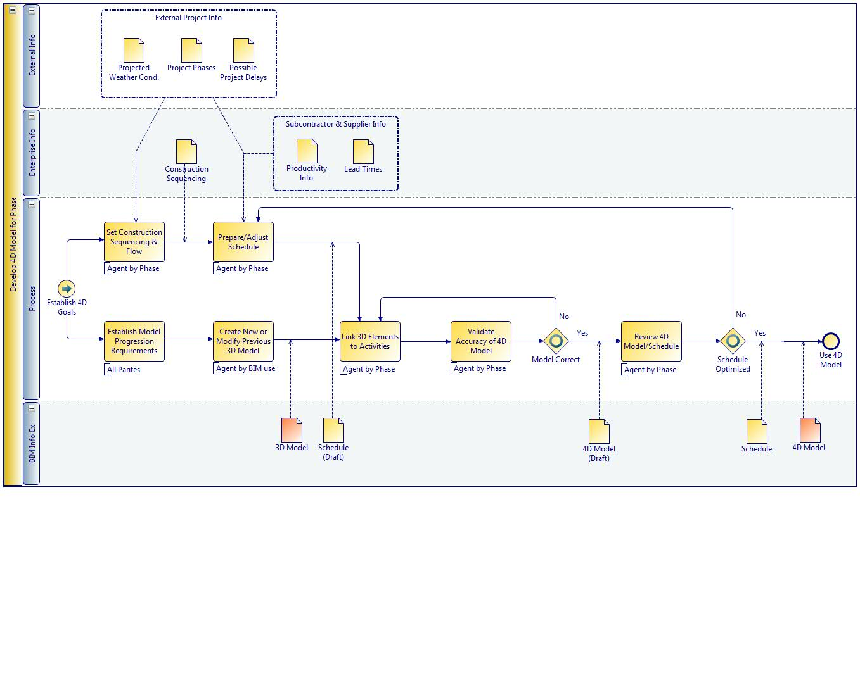
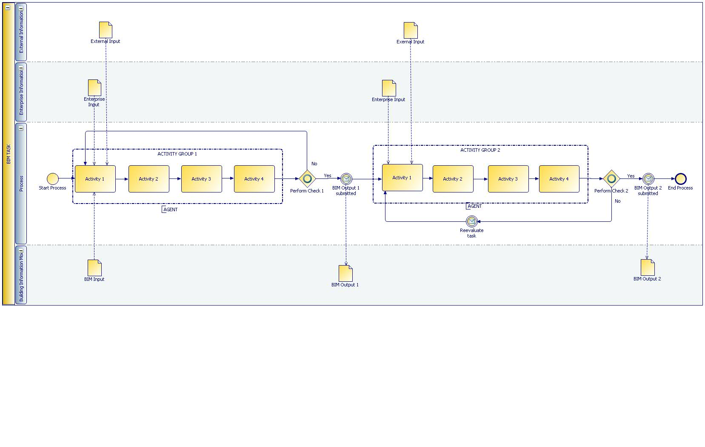
Designing the Design Model
Introduction Process Mapping MPR Conclusion
Company and Project level maps to establish a workflow for specific BIM uses
Chitwan Saluja created a 6 step procedure and a standard swim-lane layout
Step 1: Hierarchically decompose the task into a set of activities.
Step 2: Define the dependency with other activities.
Step 3: Break up every activity within the task (repeat a-c)
a: RESOURCE: Identify the resource to be used
b: RESULT: Define intermediate and final results in the form of BIM models, and information exchange required for the activity.
c: AGENT: the agent performing the activity.
Step 4: Check if the results have been met – e.g.: decision making criteria, entry – exit criteria.
Step 5: The feedback to be provided to other agents concerned (e.g.: the client for his approval of the estimation, the designer, etc.)
Step 6: Document, review and redesign this process for further use.
Shane Goodman Detroit Integrated Transportation Campus

Slide 19
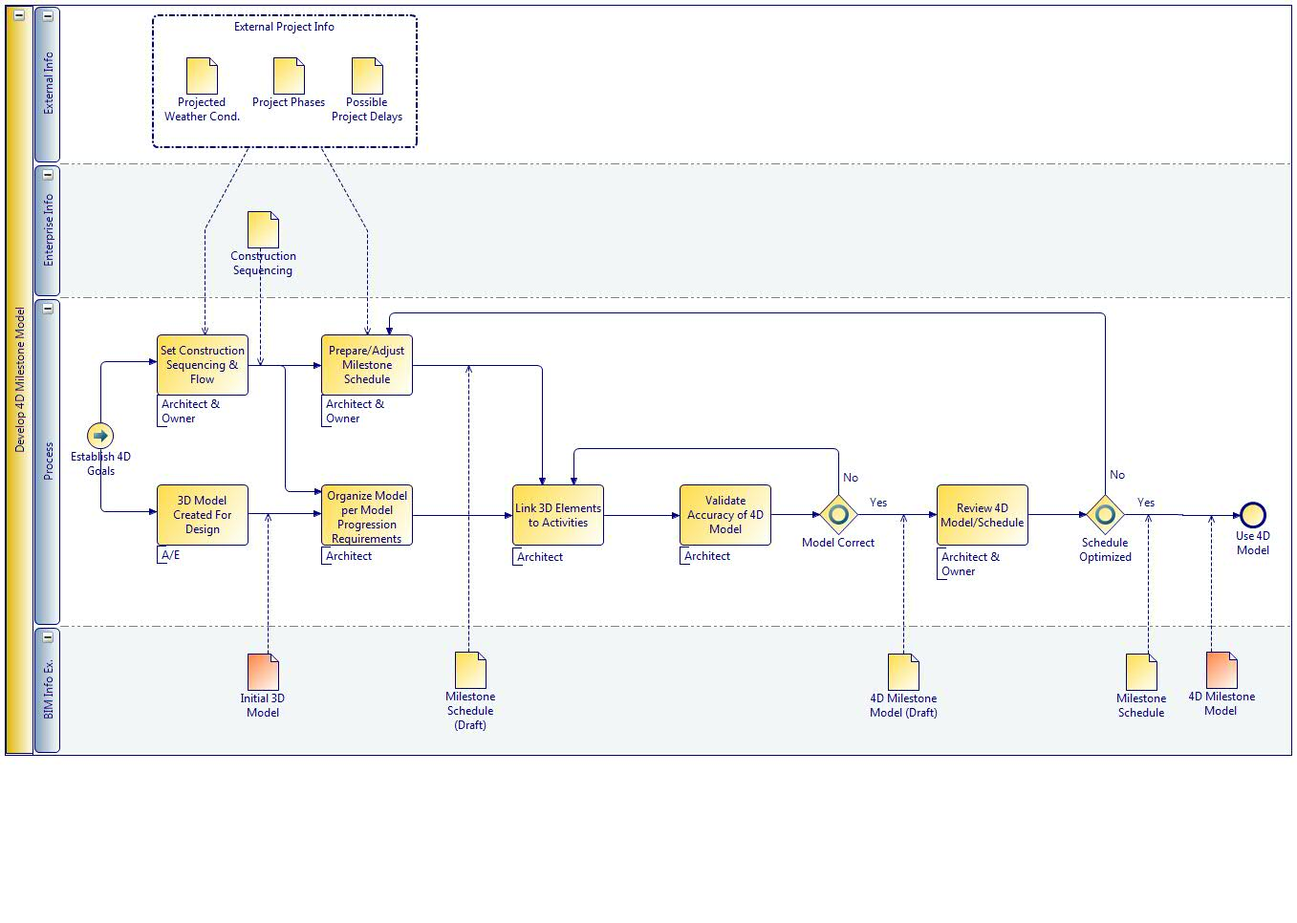
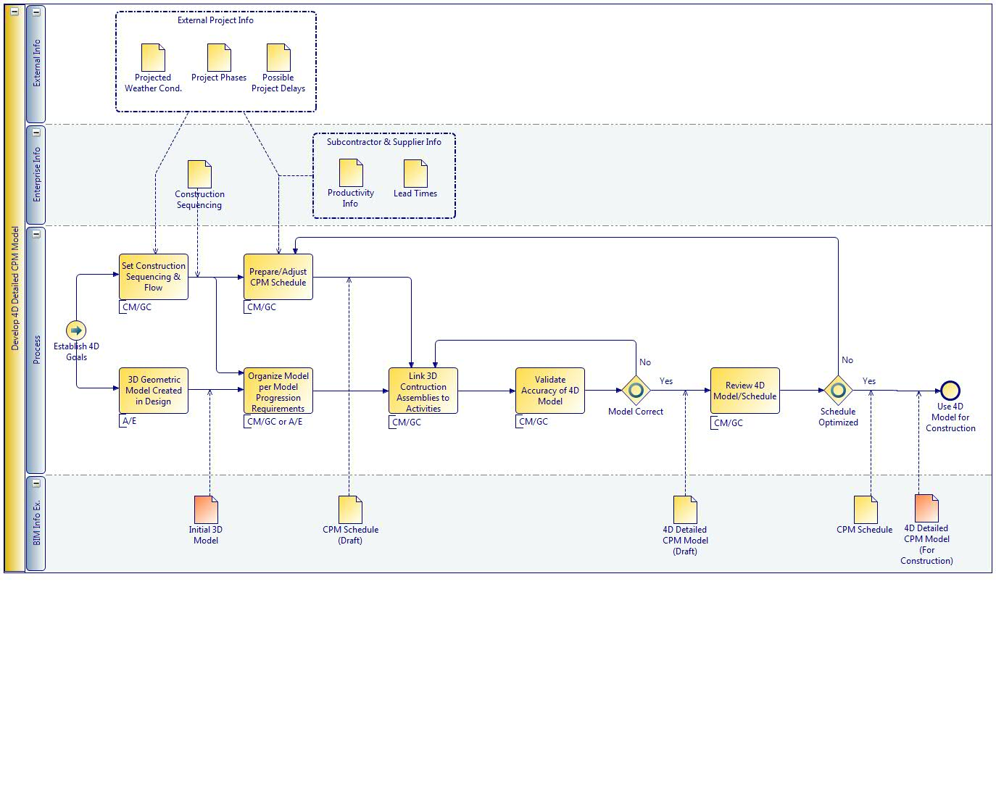
Designing the Design Model
Introduction Process Mapping MPR Conclusion
Develop 4D Milestone Model -and- Develop 4D Detailed CPM Model
Specific Agents identified
Specific Inputs and Outputs Identified
Overall process remained very similar
Shane Goodman Detroit Integrated Transportation Campus

Slide 20
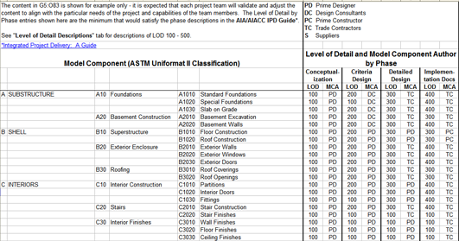
Designing the Design Model
Introduction Process Mapping MPR Conclusion
Model Progression Requirements
Identify Model Content (Part 1) |  | Identify Model Content Requirements (Part 2)
Model Content |  | Use 1: |  |  | Use 2: |  |  | Use 3: |  |  | Use 4:
Foundations |  | LOD | Grouping |  | LOD | Grouping |  | LOD | Grouping |  | LOD | Grouping
Basement Construction |  | LOD | Grouping |  | LOD | Grouping |  | LOD | Grouping |  | LOD | Grouping
Superstructure |  | LOD | Grouping |  | LOD | Grouping |  | LOD | Grouping |  | LOD | Grouping
Exterior Closure |  | LOD | Grouping |  | LOD | Grouping |  | LOD | Grouping |  | LOD | Grouping
Roofing |  | LOD | Grouping |  | LOD | Grouping |  | LOD | Grouping |  | LOD | Grouping
Interior Construction |  | LOD | Grouping |  | LOD | Grouping |  | LOD | Grouping |  | LOD | Grouping
Staircases |  | LOD | Grouping |  | LOD | Grouping |  | LOD | Grouping |  | LOD | Grouping
Interior Finishes |  | LOD | Grouping |  | LOD | Grouping |  | LOD | Grouping |  | LOD | Grouping
Conveying Systems |  | LOD | Grouping |  | LOD | Grouping |  | LOD | Grouping |  | LOD | Grouping
Plumbing |  | LOD | Grouping |  | LOD | Grouping |  | LOD | Grouping |  | LOD | Grouping
HVAC |  | LOD | Grouping |  | LOD | Grouping |  | LOD | Grouping |  | LOD | Grouping
Fire Protection |  | LOD | Grouping |  | LOD | Grouping |  | LOD | Grouping |  | LOD | Grouping
Electrical |  | LOD | Grouping |  | LOD | Grouping |  | LOD | Grouping |  | LOD | Grouping
Equipment |  | LOD | Grouping |  | LOD | Grouping |  | LOD | Grouping |  | LOD | Grouping
Furnishings |  | LOD | Grouping |  | LOD | Grouping |  | LOD | Grouping |  | LOD | Grouping
Special Construction |  | LOD | Grouping |  | LOD | Grouping |  | LOD | Grouping |  | LOD | Grouping
Building Sitework |  | LOD | Grouping |  | LOD | Grouping |  | LOD | Grouping |  | LOD | Grouping
Construction Systems and Equipment |  | LOD | Grouping |  | LOD | Grouping |  | LOD | Grouping |  | LOD | Grouping
Temporary Safety and Security |  | LOD | Grouping |  | LOD | Grouping |  | LOD | Grouping |  | LOD | Grouping
Temporary Facilities & Weather Protect. |  | LOD | Grouping |  | LOD | Grouping |  | LOD | Grouping |  | LOD | Grouping
Construction Activity Space |  | LOD | Grouping |  | LOD | Grouping |  | LOD | Grouping |  | LOD | Grouping
Project Information |  | LOD | Grouping |  | LOD | Grouping |  | LOD | Grouping |  | LOD | Grouping
Facility Spaces |  | LOD | Grouping |  | LOD | Grouping |  | LOD | Grouping |  | LOD | Grouping
AIA Document E202-2008: BIM Protocol Exhibit
Level of Detail (LOD) and Model Element Author (MEA)
Problems with AIA Document E202-2008
CSI Uniformat not effective at dividing model elements required for BIM use
Project Phases do not successfully differentiate the requirements for different BIM uses
Generic LOD (100-500) can not entirely define the detail requirements of model elements
There is no space for the grouping requirements of model elements
Model Element Author can be defined by work package
Model Progression Requirements Document (MPR)
Shane Goodman Detroit Integrated Transportation Campus

Slide 21
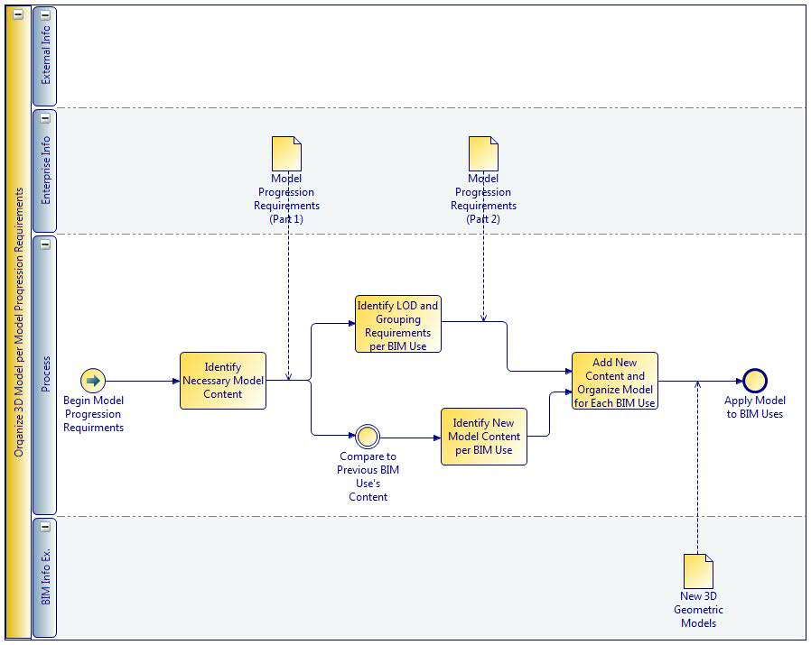
Designing the Design Model
Introduction Process Mapping MPR Conclusion
Model Progression Requirements
Identify Model Content (Part 1) |  | Identify Model Content Requirements (Part 2)
Model Content |  | Use 1: |  |  | Use 2: |  |  | Use 3: |  |  | Use 4:
Foundations |  | LOD | Grouping |  | LOD | Grouping |  | LOD | Grouping |  | LOD | Grouping
Basement Construction |  | LOD | Grouping |  | LOD | Grouping |  | LOD | Grouping |  | LOD | Grouping
Superstructure |  | LOD | Grouping |  | LOD | Grouping |  | LOD | Grouping |  | LOD | Grouping
Exterior Closure |  | LOD | Grouping |  | LOD | Grouping |  | LOD | Grouping |  | LOD | Grouping
Roofing |  | LOD | Grouping |  | LOD | Grouping |  | LOD | Grouping |  | LOD | Grouping
Interior Construction |  | LOD | Grouping |  | LOD | Grouping |  | LOD | Grouping |  | LOD | Grouping
Staircases |  | LOD | Grouping |  | LOD | Grouping |  | LOD | Grouping |  | LOD | Grouping
Interior Finishes |  | LOD | Grouping |  | LOD | Grouping |  | LOD | Grouping |  | LOD | Grouping
Conveying Systems |  | LOD | Grouping |  | LOD | Grouping |  | LOD | Grouping |  | LOD | Grouping
Plumbing |  | LOD | Grouping |  | LOD | Grouping |  | LOD | Grouping |  | LOD | Grouping
HVAC |  | LOD | Grouping |  | LOD | Grouping |  | LOD | Grouping |  | LOD | Grouping
Fire Protection |  | LOD | Grouping |  | LOD | Grouping |  | LOD | Grouping |  | LOD | Grouping
Electrical |  | LOD | Grouping |  | LOD | Grouping |  | LOD | Grouping |  | LOD | Grouping
Equipment |  | LOD | Grouping |  | LOD | Grouping |  | LOD | Grouping |  | LOD | Grouping
Furnishings |  | LOD | Grouping |  | LOD | Grouping |  | LOD | Grouping |  | LOD | Grouping
Special Construction |  | LOD | Grouping |  | LOD | Grouping |  | LOD | Grouping |  | LOD | Grouping
Building Sitework |  | LOD | Grouping |  | LOD | Grouping |  | LOD | Grouping |  | LOD | Grouping
Construction Systems and Equipment |  | LOD | Grouping |  | LOD | Grouping |  | LOD | Grouping |  | LOD | Grouping
Temporary Safety and Security |  | LOD | Grouping |  | LOD | Grouping |  | LOD | Grouping |  | LOD | Grouping
Temporary Facilities & Weather Protect. |  | LOD | Grouping |  | LOD | Grouping |  | LOD | Grouping |  | LOD | Grouping
Construction Activity Space |  | LOD | Grouping |  | LOD | Grouping |  | LOD | Grouping |  | LOD | Grouping
Project Information |  | LOD | Grouping |  | LOD | Grouping |  | LOD | Grouping |  | LOD | Grouping
Facility Spaces |  | LOD | Grouping |  | LOD | Grouping |  | LOD | Grouping |  | LOD | Grouping
To help users complete the Model Progression Requirements Document:
Procedure
Define the intended BIM uses for a project across the top of the BIM Use columns. List chronologically from left to right.
2. Identify the necessary Model Content down the left hand side.
3. Work through each BIM Use defining the LOD and Grouping requirements for all Model Content.
Shane Goodman Detroit Integrated Transportation Campus

Slide 22
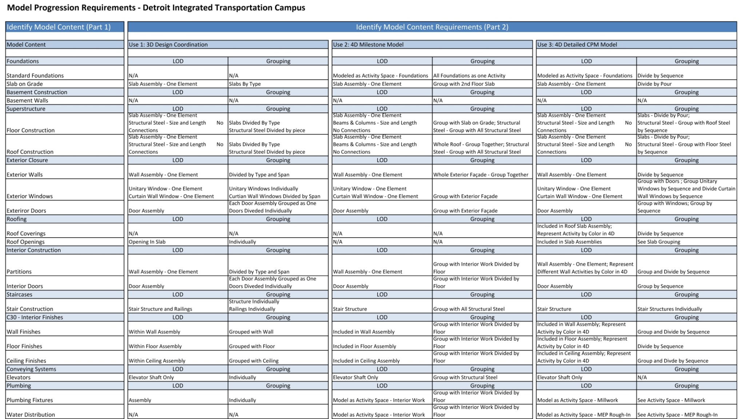
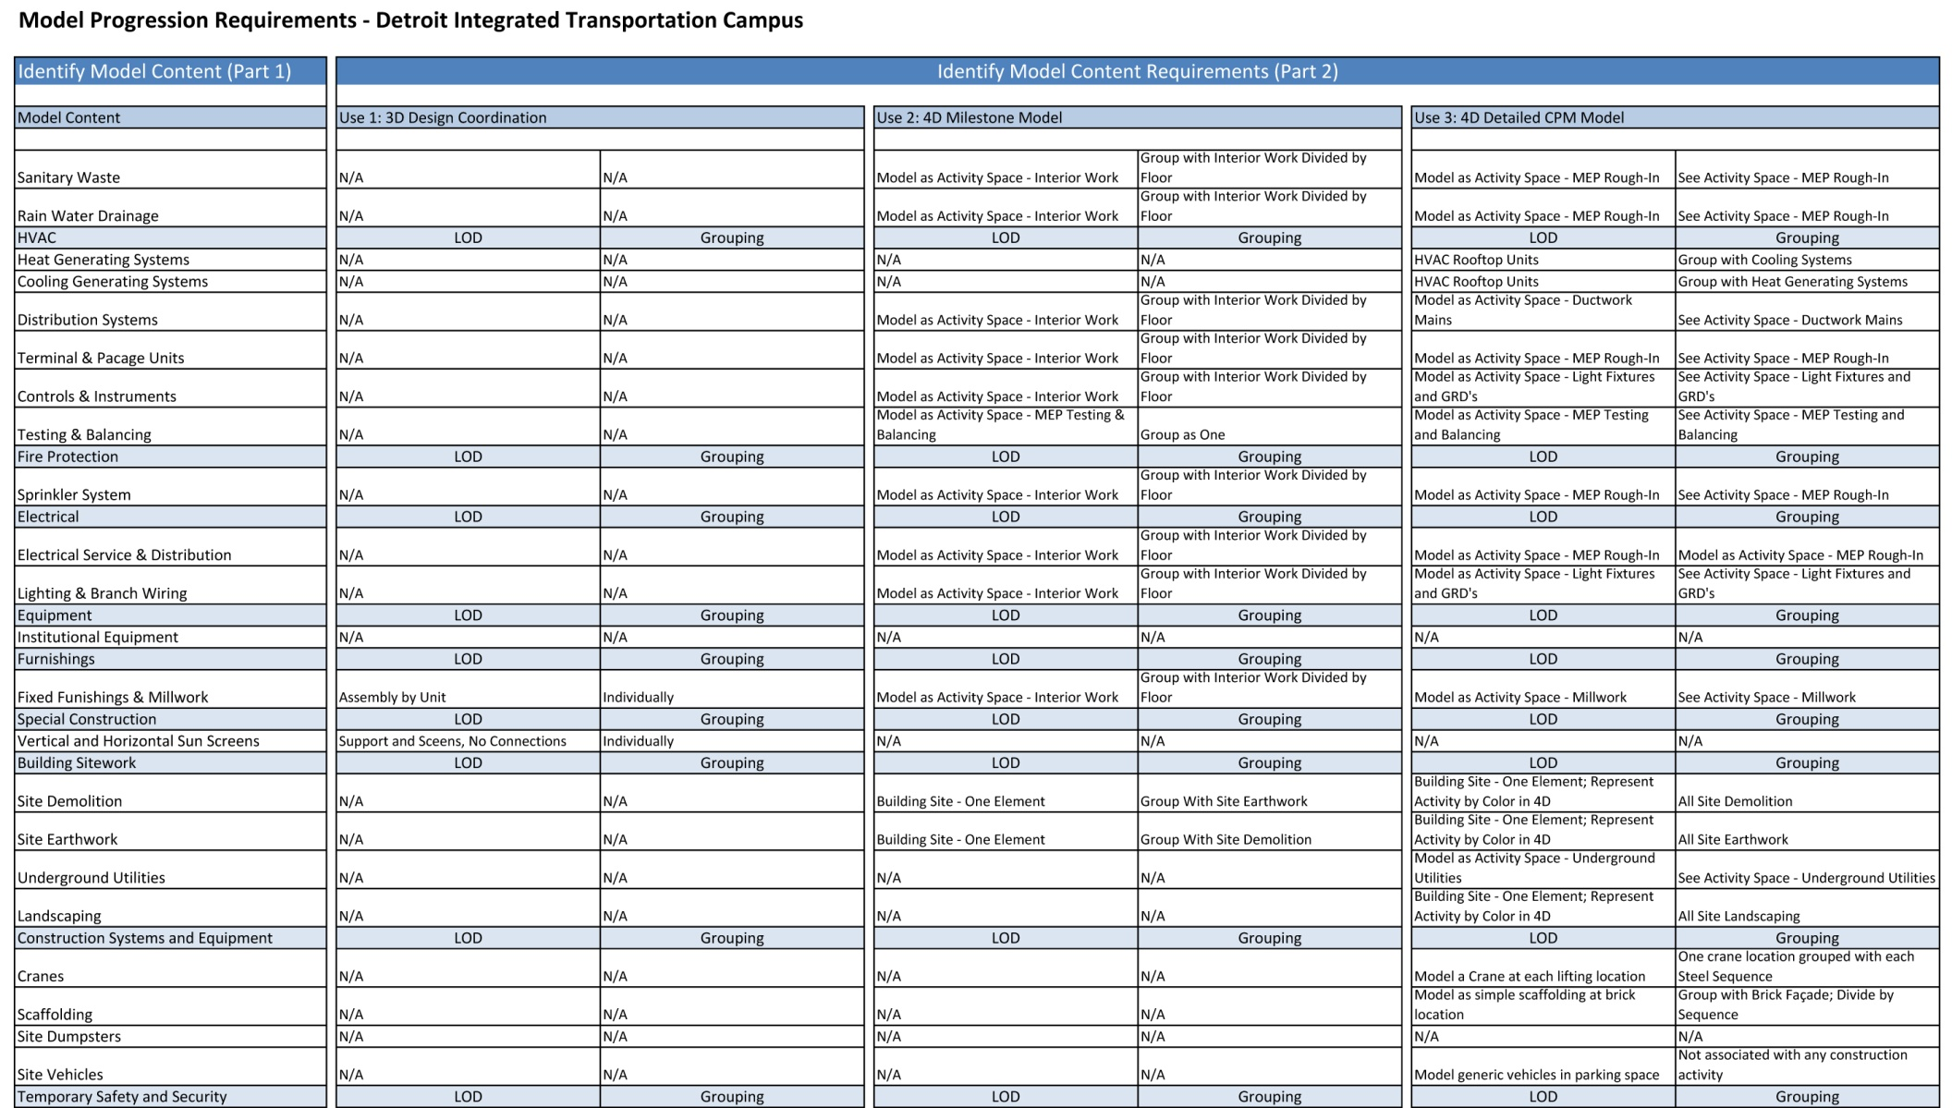
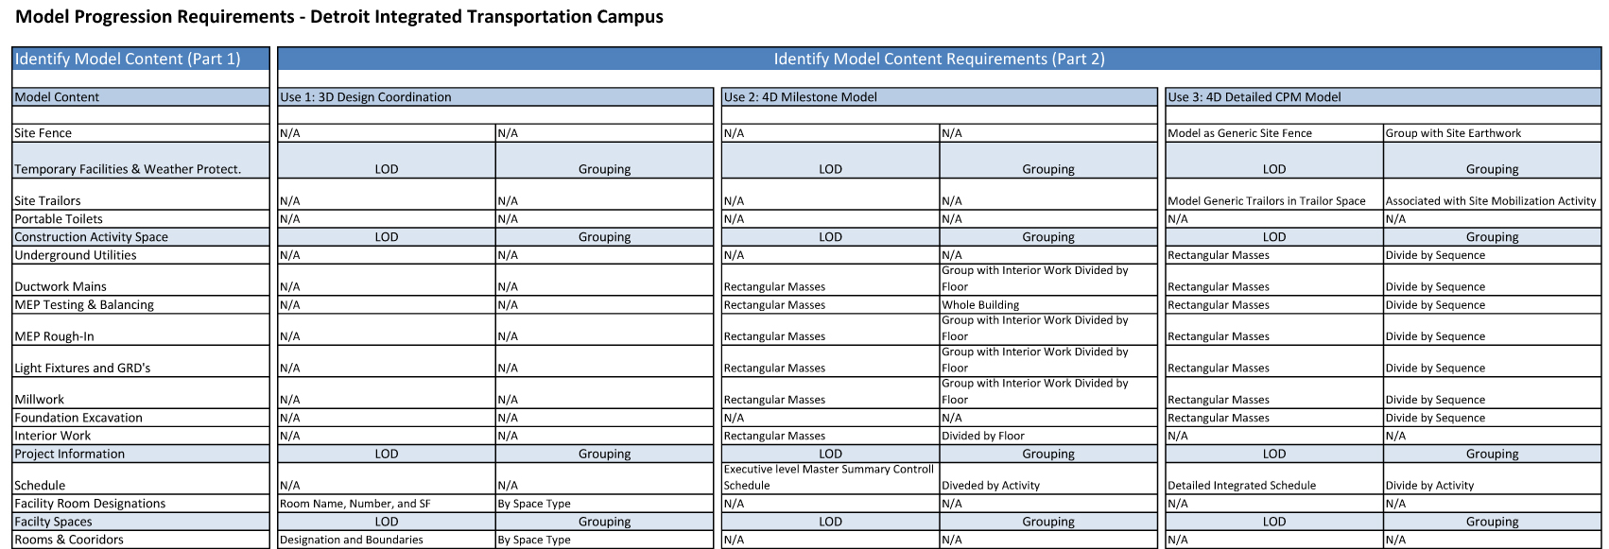
Designing the Design Model
Introduction Process Mapping MPR Conclusion
Shane Goodman Detroit Integrated Transportation Campus

Slide 23
Designing the Design Model
Introduction Process Mapping MPR Conclusion
Editing generic process map to represent project specific processes was simple
AIA Document E202 is good for defining progression, however it is missing key elements: Doesn’t cover all BIM uses and doesn’t properly describe LOD required
DITC falls under category of inadequate interoperability
In order to help implement the industry wide adoption of BIM, the AEC industry should utilize process mapping and model progression documents to develop BIM Execution Plans on both a company and project level.
Ideally…
Shane Goodman Detroit Integrated Transportation Campus

Slide 24
Acknowledgements
Penn State AE Faculty
John Messner David Riley Linda Hanagan
Walt Schneider Kevin Parfitt Robert Holland
BIM Execution Planning Team
Chimay Anumba John Messner Craig Dubler Colleen Kasprzak Chitwan Saluja Nevena Zikic BIMex Advisory Board
Design and Construction Division
Construction Industry Institute
Special Thanks to my Family & Friends
Shane Goodman Detroit Integrated Transportation Campus

Slide 25
Questions
OUTLINE
Prefab with Precast Brick Panels
Modularization of Interior Walls
Designing the Design Model
Penn State AE Faculty
John Messner David Riley Linda Hanagan
Walt Schneider Kevin Parfitt Robert Holland
BIM Execution Planning Team
Chimay Anumba John Messner Craig Dubler Colleen Kasprzak Chitwan Saluja Nevena Zikic BIMex Advisory Board
Shane Goodman Detroit Integrated Transportation Campus
Special Thanks to my Family & Friends

Slide 26
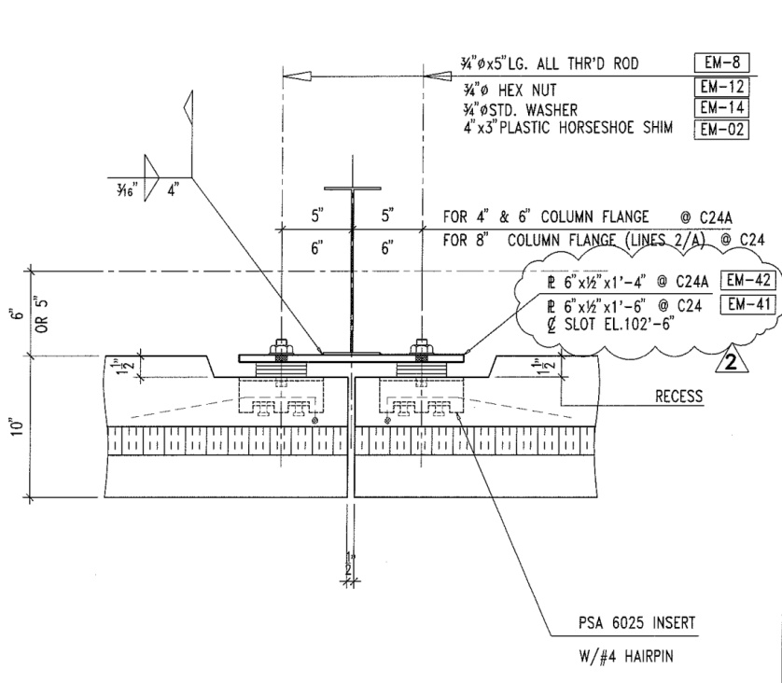
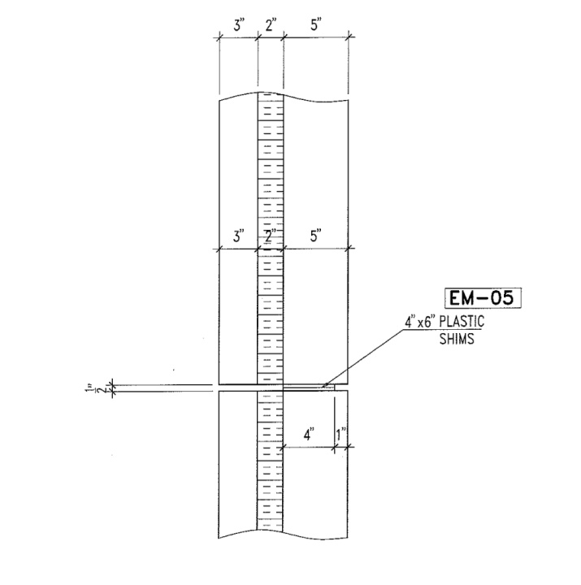
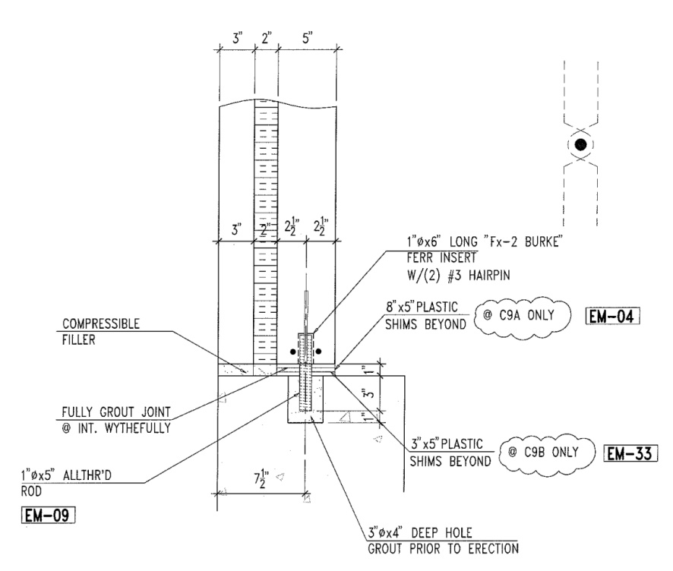
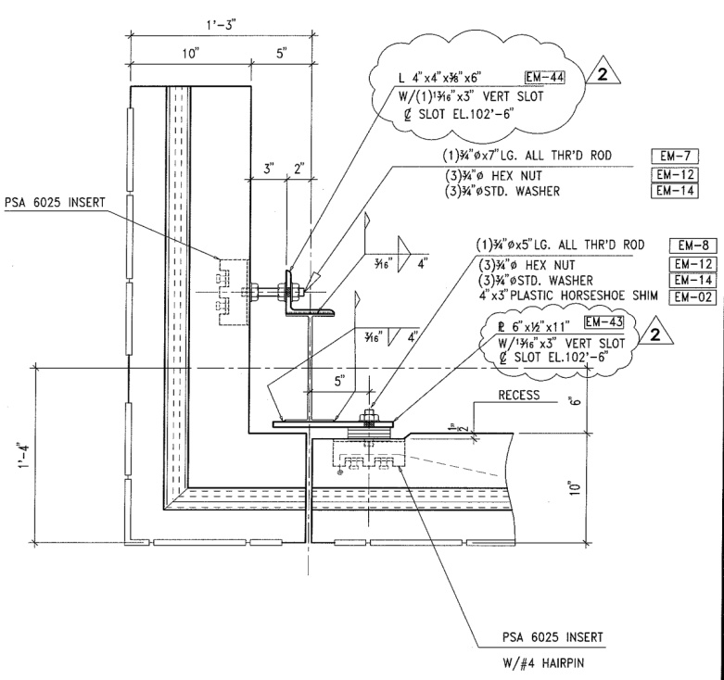
Prefab with Precast Brick Panels
Panel System Structural Schedule Cost Conclusion
Foundation Horizontal Joint
Corner Joint Vertical Joint
Prefabricated: high-speed on-site construction
High R-Value: decrease in heating and cooling loads
Fiber-Composite Connectors: high strength & low conductivity
3”-2”-5” configuration
20’ – 22’ wide x 8’ 6” high (one-third of DITC façade)
Shane Goodman Detroit Integrated Transportation Campus

Slide 27
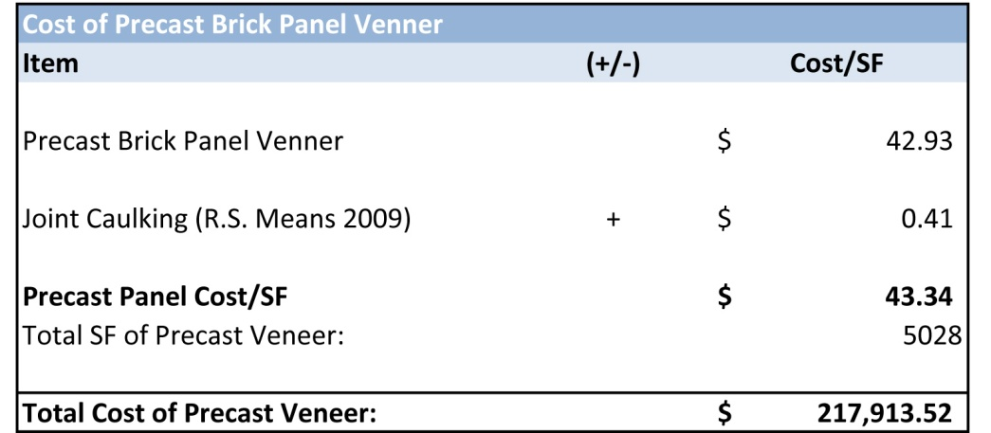
Prefab with Precast Brick Panels
Panel System Structural Schedule Cost Conclusion
National Precast Estimate: $ 215,850 or $ 42.93 / SF
Payback Period
$ 453 annual savings in heating and cooling costs
$ 8,712 / $ 453 per year =
Payback Period of 19 years
Shane Goodman Detroit Integrated Transportation Campus

Slide 28
Modularization of Interior Walls
IrisWall System Schedule Cost Conclusion
IrisWall
Located near Cleveland, Ohio
Face: 95% Recycled, Aluminum: 65-85% Recycled, Water-based finishes
Doors and Windows come finished and can match any existing specifications
Electrical raceways can be prefabricated in panels
Surrounding system design should be flexible: flex duct, longer wiring and adjustable sprinkler heads
IrisWall substituted for drywall in areas with drop ceiling and not for MEP walls
Shane Goodman Detroit Integrated Transportation Campus

Slide 29
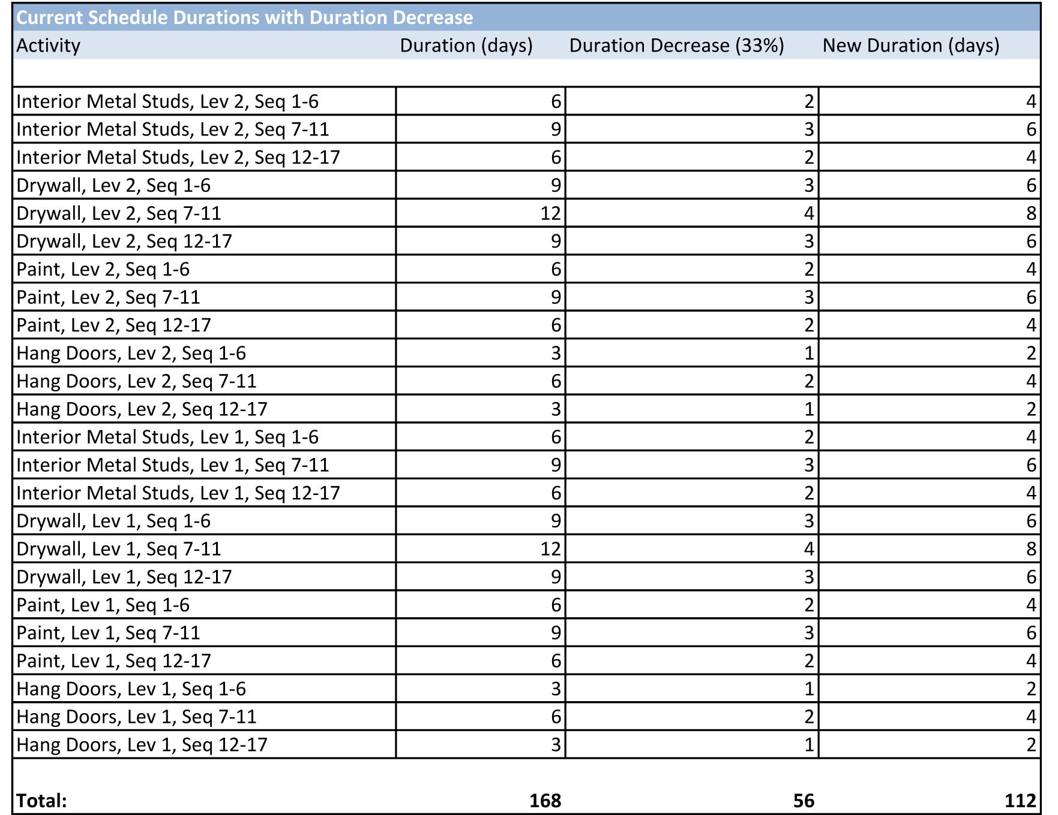
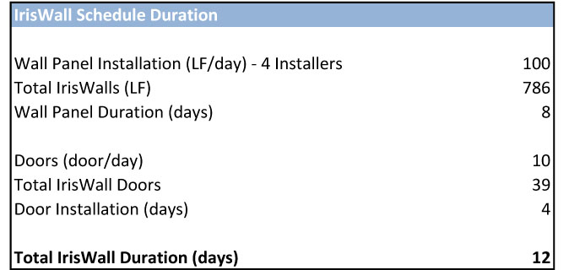
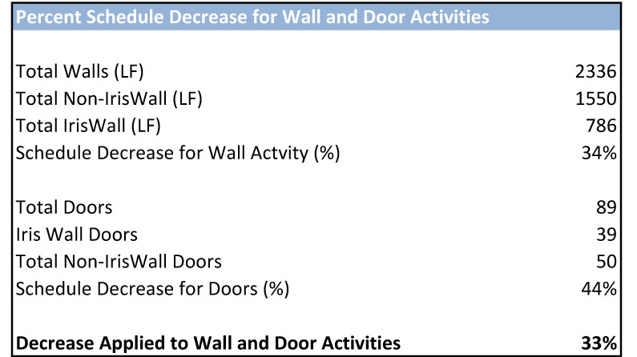
Modularization of Interior Walls
IrisWall System Schedule Cost Conclusion
Durations for IrisWall received from EWS and applied to the DITC
IrisWall added after Floor Finishes and before Light Fixture Installation
Schedule Decreases were found by percent of original wall activities replaced by IrisWall
Construction Schedule decreased by 6 days
General Conditions savings at $ 633 per day = $ 3,800
Total Duration Saved = 56 days - 12 days = 44 days
Shane Goodman Detroit Integrated Transportation Campus

Slide 30
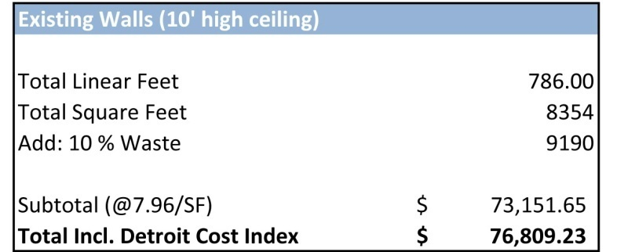
Existing Drywall on Metal Stud, Door & Window Cost
Clean-up, Carpet, and Electrical Savings with IrisWall
Modularization of Interior Walls
IrisWall System Schedule Cost Conclusion
IrisWall Return on Investment
Offers Tax and Renovation savings that can provide for a quick ROI
Classified as furniture: 7 year depreciation, compared to 39 years for drywall
Assuming a 10% per year move rate, and 5% inflation rate:
Payback Period for IrisWall on DITC = 60 months
Shane Goodman Detroit Integrated Transportation Campus

